Slide 1
CAPSTONE PROJECT
HANDWRITTEN DIGIT RECOGNITION USING DEEP LEARNING
TEAM MEMBERS:
Vasanthakumar.P(18BCS0022)
Manibharathi.S(18BCS0023)
E.Nithyashri(18BCS0070)
MENTOR:
Dr.VANITHA.M

Slide 2
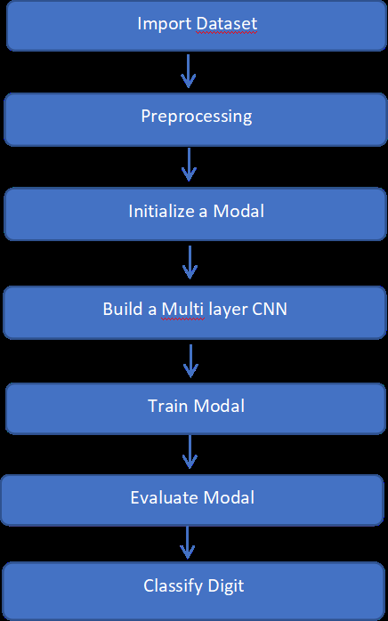
ABSTRACT
SYSTEM ARCHITECTURE
Handwritten transcription can easily be identified and understood by humans, but computer cannot identify as easily as humans because different handwriting has different patterns to spot.
This project is built based upon the most vital and integral concepts of Deep learning and Conventional Neural Networks,(CNN) along with the essential libraries and tools like Tensorflow, Keras.

Slide 3
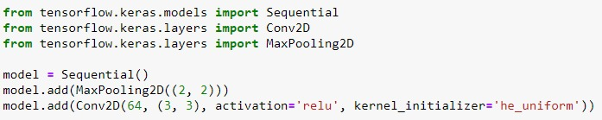
CNN (Convolutional Neural Network)
A convolutional neural network is a subset of deep neural networks, most commonly applied to analyze two dimensional data(Image and Video).
Convolutional Layer
This layer uses a filter (also called as kernel) which is an array of weights to extract features from the input image. One layer can have many filters.
Conv2D class from tensorflow is used to create an instance of Convolutional layer.

Slide 4
Pooling Layer
This layer reduces the dimensions of the data coming from Convolutional layer which in return reduces the computations, number of parameters, reduces overfitting and therefore making the entire process much faster.
MaxPooling has been used
MaxPooling2D class from TensorFlow is used to create an instance of Pooling layer.
Fully Connected Layer(FC layer):
A fully connected neural network consists of a series of fully connected layers that connect every neuron in one layer to every neuron in the other layer.
The input to the fully connected layer is the output from the final Pooling or Convolutional Layer, which is flattened and then fed into the fully connected layer.
The major advantage of fully connected networks is that they are “structure agnostic”

Slide 5
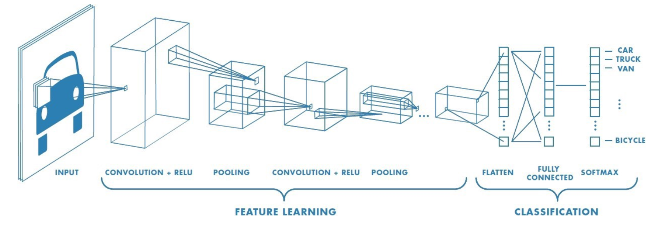
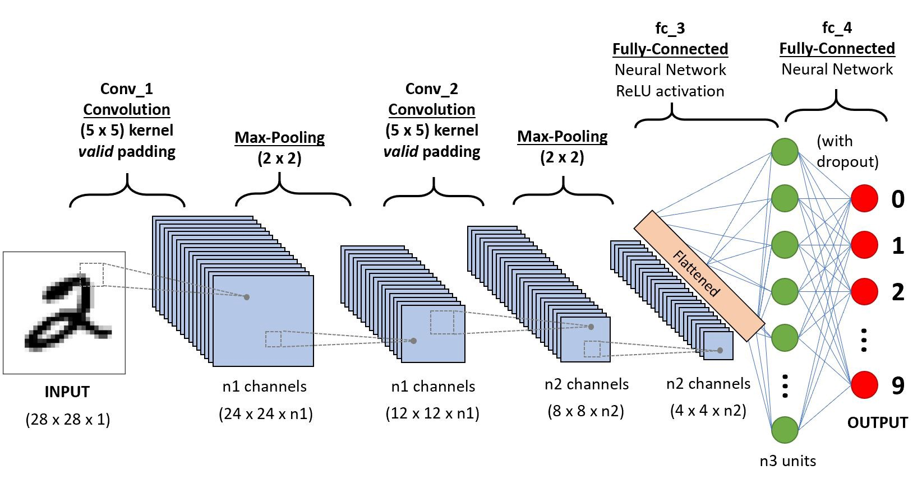

Slide 6

Activation function
Used in the hidden layers of a neural network. This allows the model to learn more complex functions than a network trained using a linear activation function. Two activation functions are used
ReLU (Rectified Linear Unit)
- Conv2D instance provides an easy way of adding ReLU function
Softmax
- Commonly used in Output Layer for Multiclass Classification
- It returns a Probablity distrubution of target classes for a classification problem
- Conv2D instance provides an easy way of adding Softmax function
Accuracy: 99.280%

Slide 7
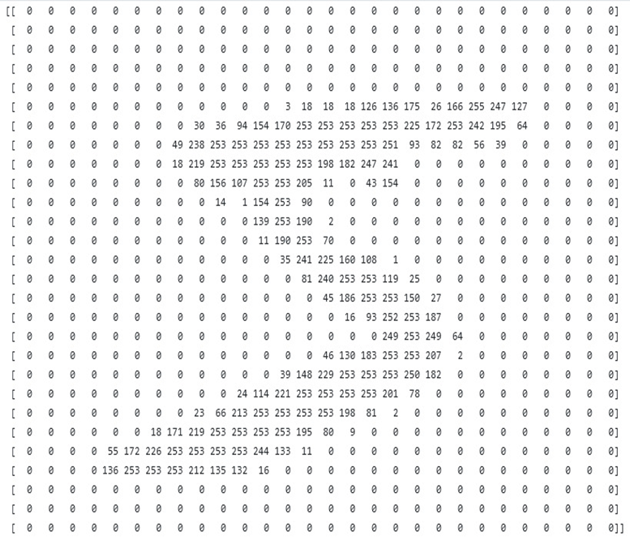
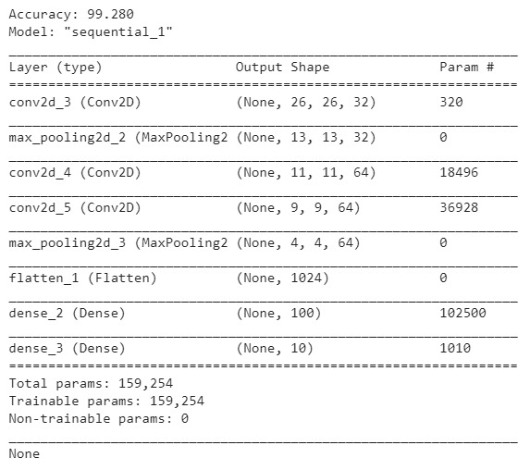
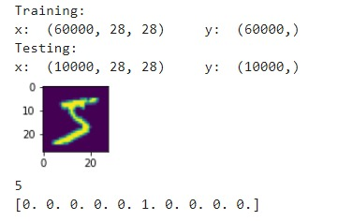

Slide 8


SVM (Support Vector Machine)
Popular Supervised learning algorithms, commonly used for classification.
Code Implementation
SVC(Support Vector Classifier) is a class from sklearn package which is being used to create a classifier (model) instance.
Accuracy: 97.92%

